Slide 1

Advanced computer programming
DR/Mahmoud Ibrahim Khalil, Nesma mohamed Ibrahim,

Slide 2
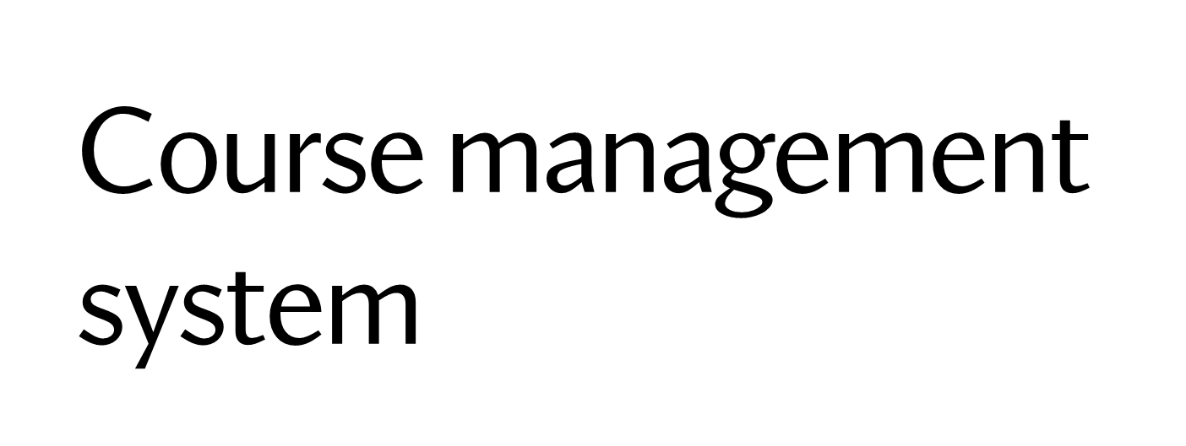
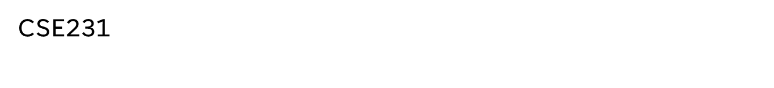
Name | ID | Role
Mohamed Waleed Elsayed | 2100623 | JavaFX , Main class ,linking classes
Abdulrahman Taha Mohamed | 2100464 | Course, Module and Review classes
Mohammed khaled mohamed | 2101103 | User, Instructor and InvalidAgeException classes
Mohamed Ashraf Mohamed Mahmoud | 2101405 | Student and StatsScene classes
Seifalla Ehab Mohamed Aziz Bayoumy | 2100619 | Assignment, Quiz and MCQ classes, Question creation Scenes(3 Scenes) in JavaFX

Slide 3
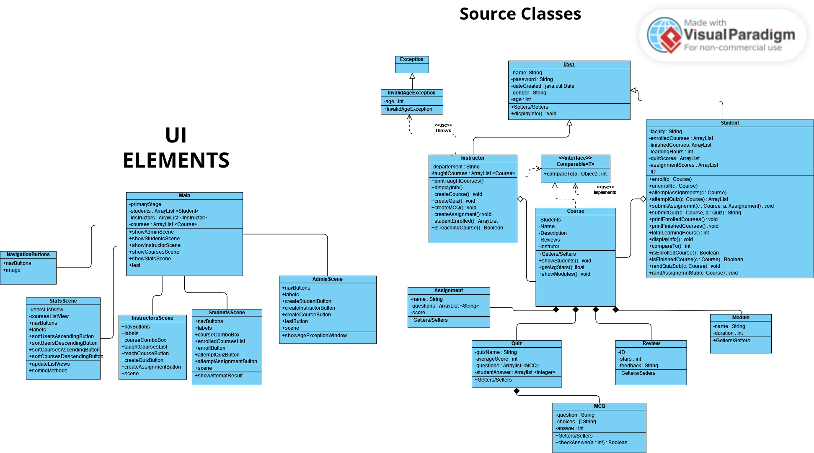

Slide 4
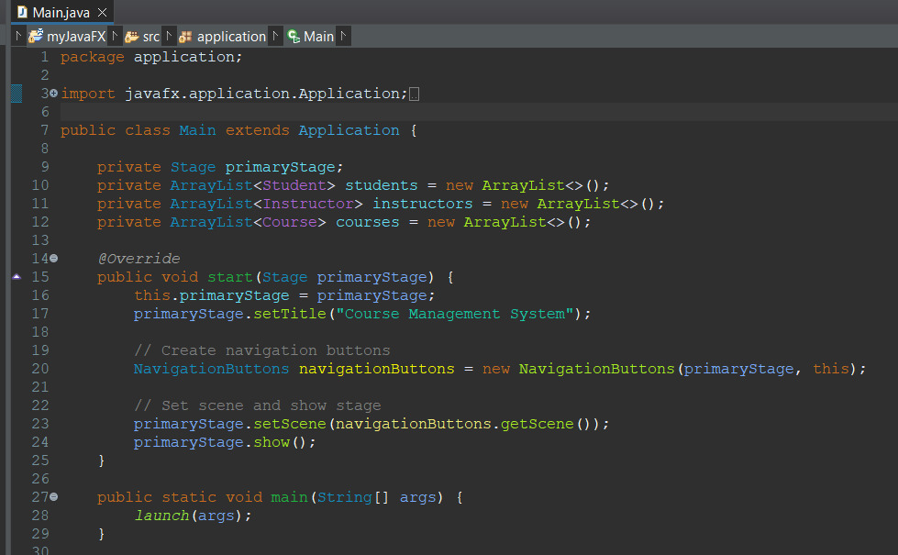
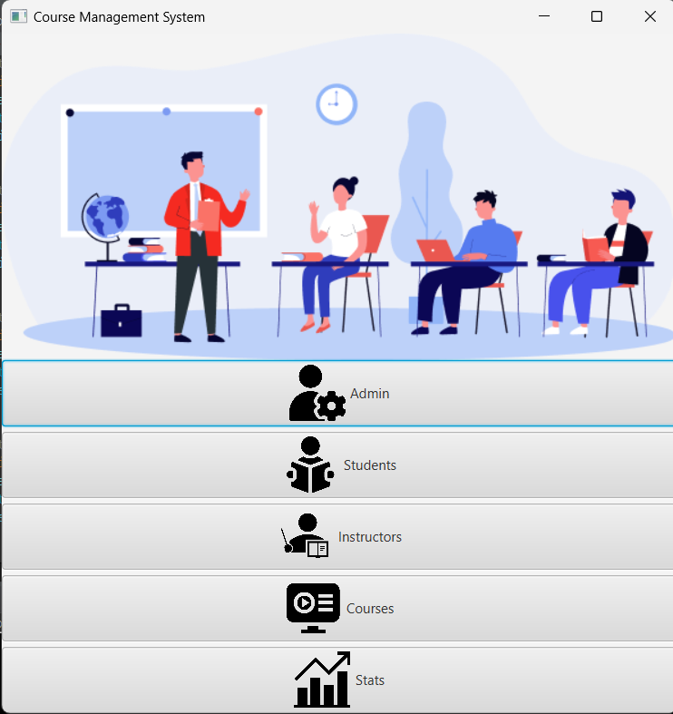
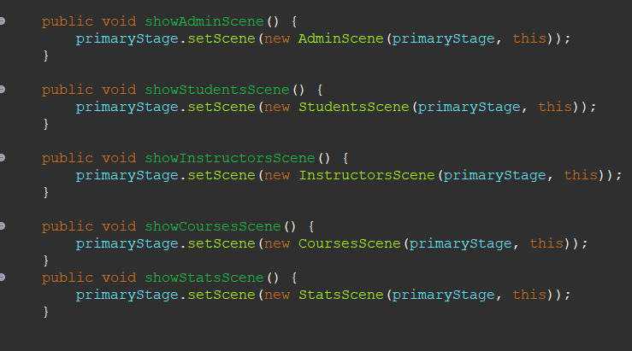
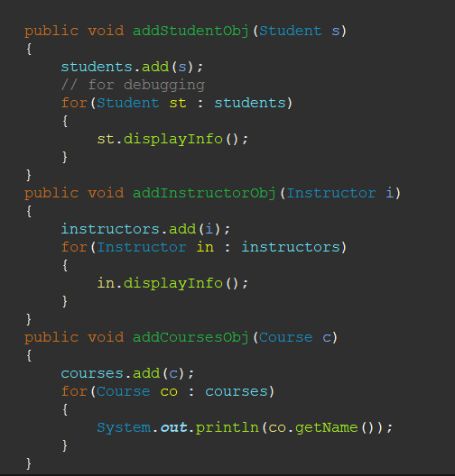
Main start
Frequent
Methods

Slide 5
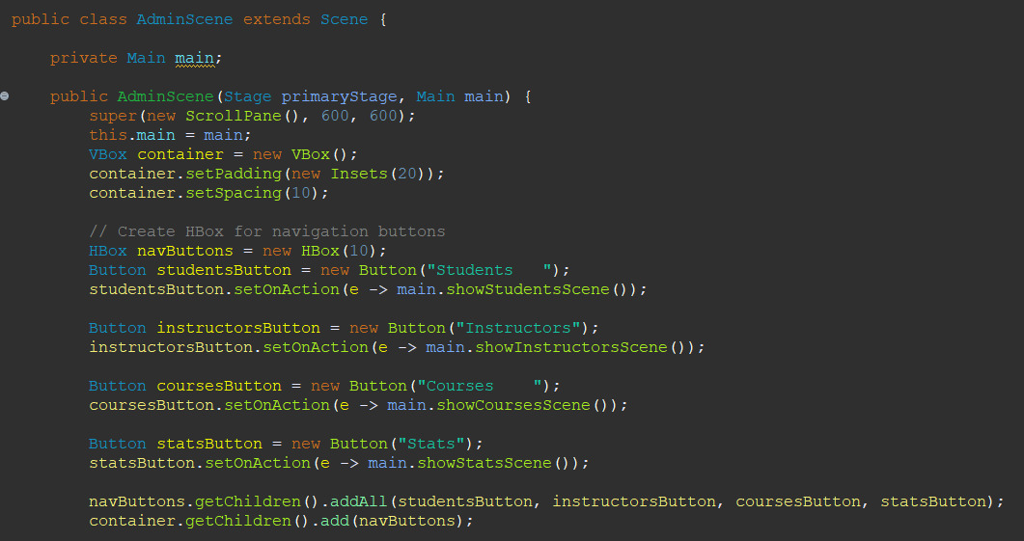
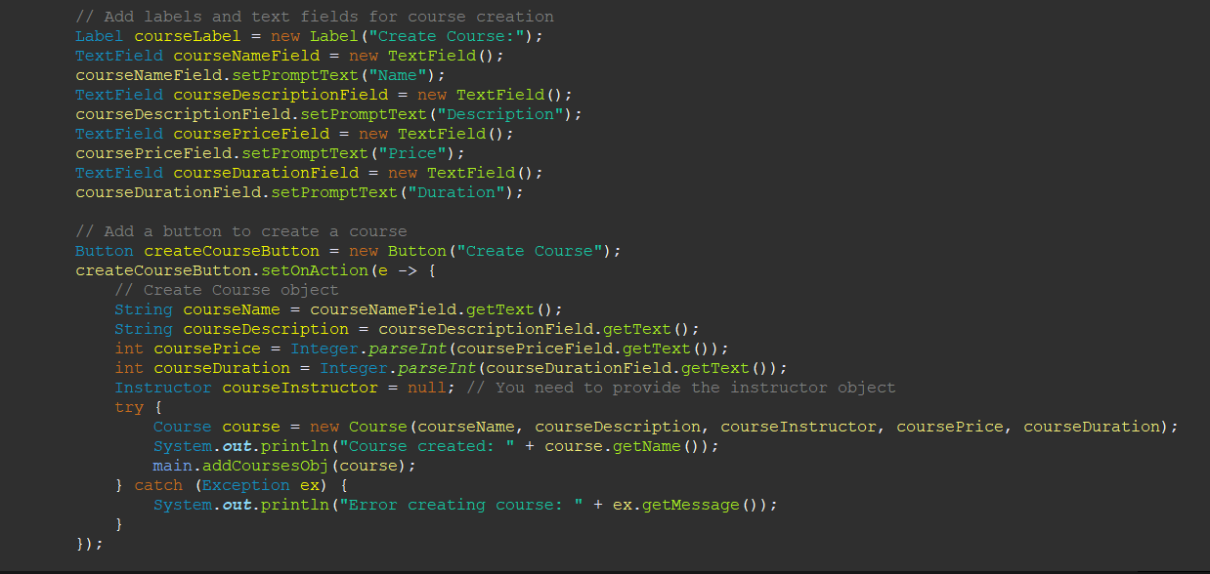
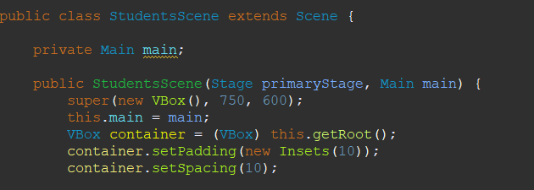
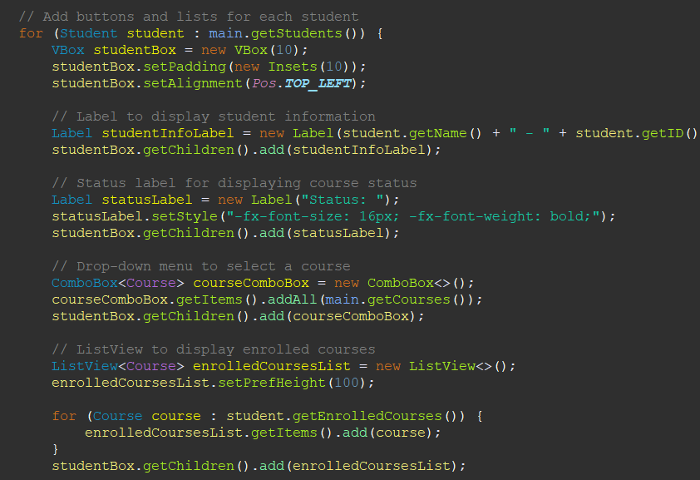
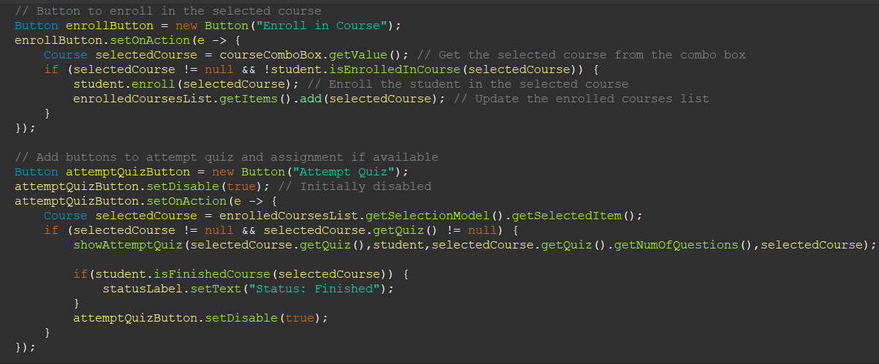
Admin Scene example
Student scene example

Slide 6
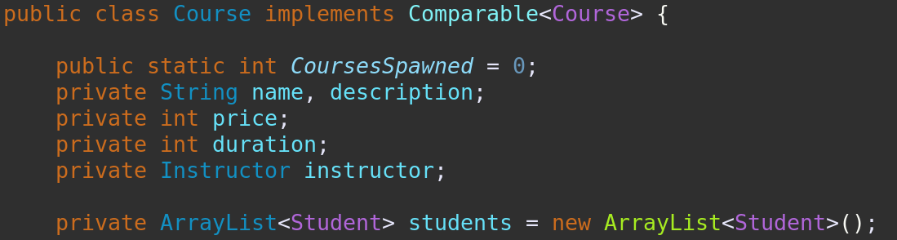
Encapsulation
Encapsulation of data fields in Course class

Slide 7
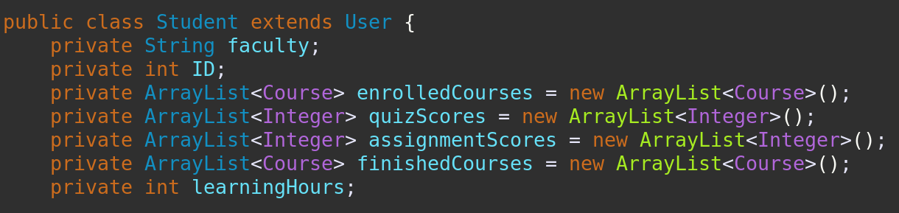
Encapsulation
Encapsulation of data fields in Student class

Slide 8
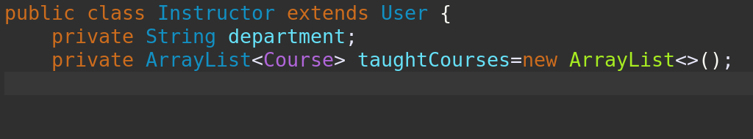
Encapsulation
Encapsulation of data fields in instructor class

Slide 9
Polymorphism:-
User is an abstract class that student and instructor inherts from .

Slide 10
Polymorphism:-
We will use javafx listview to show all users in our interface,we created listview of user allows it to contain instances of both Student and Instructor classes, as they both inherit from the User class. This declaration demonstrates polymorphism by treating instances of subclasses (Student and Instructor) as instances of the superclass (User).

Slide 11
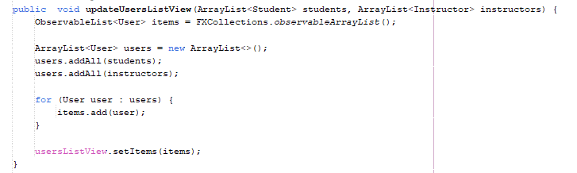
Polymorphism:-
We created method (updateUsersListView) that student arraylist and instructor arraylist Is passed to,we combine both of them in one arraylist of user ,then to observablelist to enable the list to dynamically update and reflect changes on the list view.

Slide 12
bold entity (courses )sorting :-
Course class implements interface comparable.

Slide 13
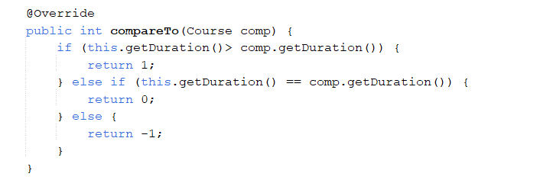
bold entity (courses )sorting :-
Course class overrides compare to method.

Slide 14
bold entity (courses )sorting :-
We will use java fx listview to show our courses,so we created listview of course.

Slide 15
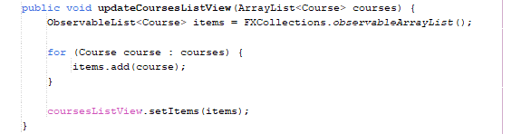
bold entity (courses )sorting :-
List view is passed to it observablelist to enable the list to dynamically update and reflect changes on the list view.

Slide 16
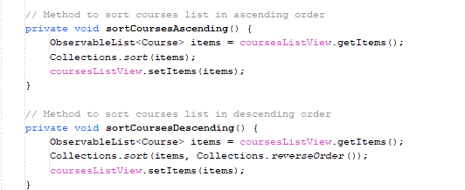
bold entity (courses )sorting :-
We imported collections to be able to sort courses ascendingly and descendingly,using Collections.sort method.

Slide 17
Exception Handling
Checked
Forced by the compiler to either throw it or handle it
Unchecked
Creates errors during runtime but the compiler doesnt force it to be handled.

Slide 18
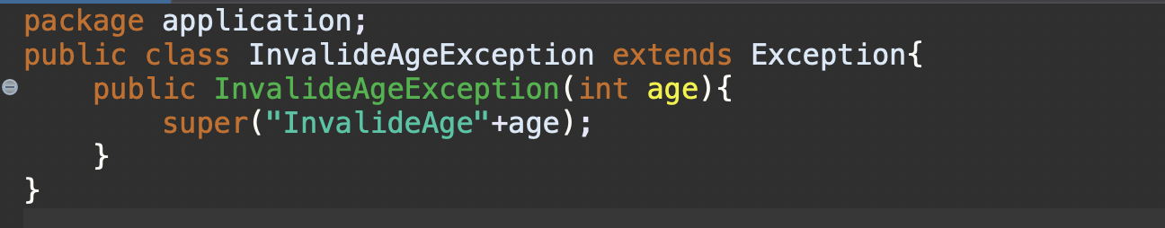
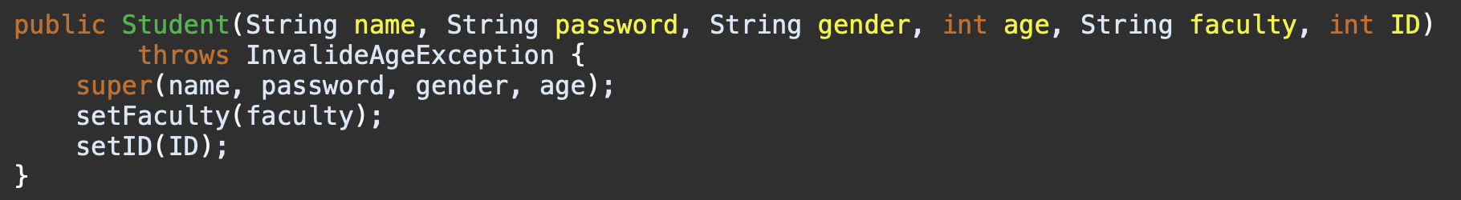
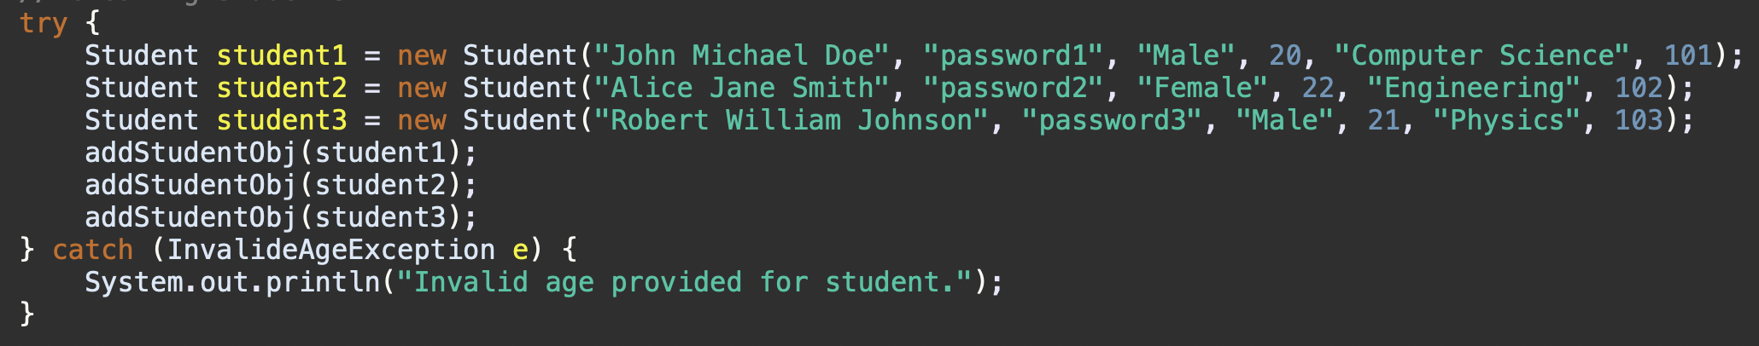
Ex: Checked Custom Exception(InvalidAgeExceotion)
Custom Exception that inherits Exception so it is a Checked Exception
Student Class constructor throws this Exception so that Any object created using this constructor is forced to either throw the exception or handle it in a try catch block
Ex: of handling the Exception in student scene after using the constructor

Slide 19
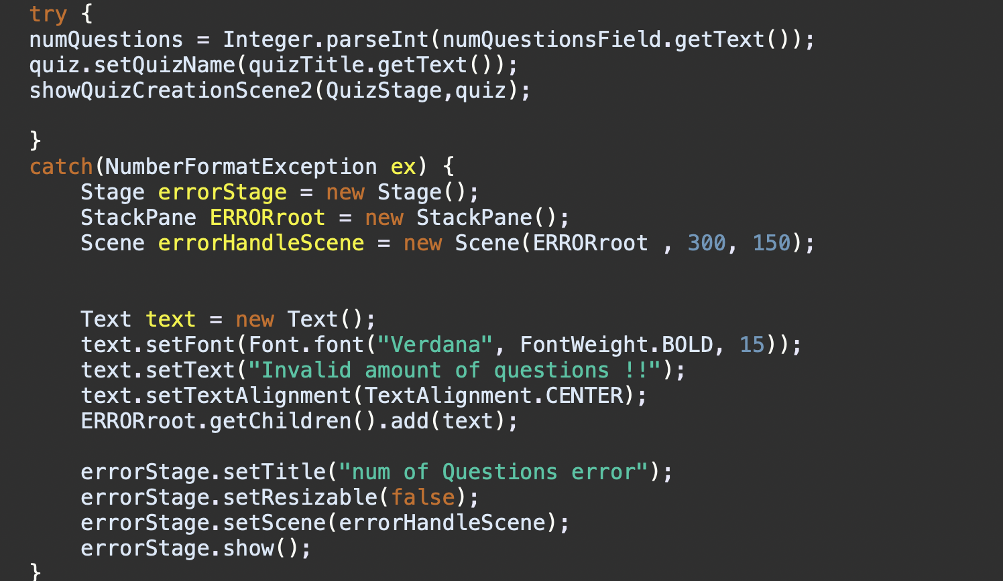
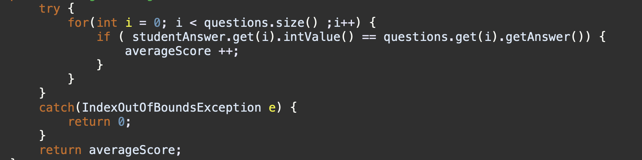
Ex: Unchecked Exceptions
NumberFormatException: In this example a parstInt was needed ,but if the UI user input wasn’t a number this fires a NumberFormatException which means that the input wasn’t a number
IndexOutOfBounds: used if the index overcedes the size of an array or an arrayList

Slide 20
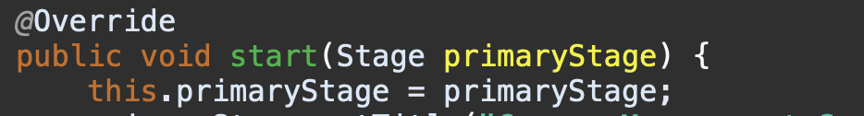
Examples on Inheritance
Main class inherits from application which is an abstract class with abstract function start so it is forced to override it
Both student and instructor inherits User which is their parent class so not every user is student but every student indeed is a user

